Slide 1
Clustering Techniques K-Means and EM technique
Team 2

Slide 2
What is clustering
Clustering is dividing data points into homogeneous classes or clusters:
Points in the same group are as similar as possible
When a collection of objects is given, we put objects into group based on similarity.
When objective data are provided, objects are divided into groups with same similarity
Applications
Provide general data information(include but not limited to data distribution, layout)
Provide further detail on how dataset should be treated properly in further steps

Slide 3
K means
The data given by x are clustered by the k-means method,
Partition the points into k groups
Sum of squares from points to the assigned cluster centers is minimized.
At the minimum, the set of data points which are nearest to the cluster center.
Mathematical Formulation for K-means Algorithm:
D= {x₁,x₂,…,x_{i},…,x_{m}} → data set of m records
x_{i}= (x_{i1},x_{i2},…,x_{in}) each record is an n-dimensional vector

Slide 4
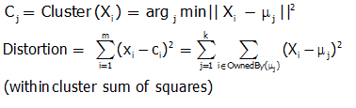

Slide 5
Scenario
A luxury products company trying to find the optimized MSRP settings that should be used for each target group of people so that to maximize their revenues for each of their product lines
In this example, let’s assume that they want to divided their target groups into 5 (k=5). And 600 data samples have been collected for this analysis

Slide 7
Expectation Maximization(EM)
In statistics, an expectation–maximization (EM) algorithm is an iterative method for finding maximum likelihood or maximum a posteriori (MAP) estimates of parameters in statistical models.

Slide 8
Expectation maximization:
EM starts with an initial guess of the parameters.
In the E-step, a probability distribution over possible completions is computed using the current parameters. The counts shown in the table are the expected numbers of heads and tails according to this distribution.
In the M-step, new parameters are determined using the current completions.
After several repetitions of the E-step and M-step, the algorithm converges.

Slide 9
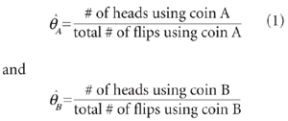

Slide 10
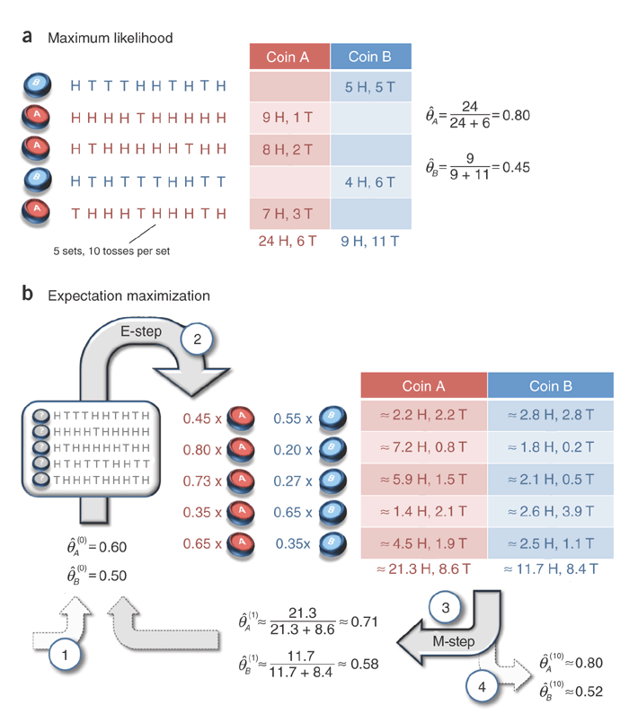

Slide 11
In summary, the expectation maximization algorithm alternates between the steps of guessing a probability distribution over completions of missing data given the current model (known as the E-step)
The re-estimating the model parameters using these completions (known as the M-step). The name 'E-step' comes from the fact that one does not usually need to form the probability distribution over completions explicitly, but rather need only compute 'expected' sufficient statistics over these completions.
Similarly, the name 'M-step' comes from the fact that model re estimation can be thought of as 'maximization' of the expected log-likelihood of the data.

